Slide 1







www.namamiindia.co.in
info@namamiindia.co.in

Slide 2


About Us
M/s. NAMAMI INDIA SUPPORT SERVICES Hospitality & Facility Management Pvt. Ltd. has been a trusted name in the facility management industry since 2019.
With a strong senior leadership team and the support of 500+ skilled and semi-skilled professionals, we ensure the efficient execution of operations and delivery of high-quality services to our clients.
NAMAMI was initially conceptualized and formed to cater to Loops’ in-house requirements, managing its Pan-India projects with state-of-the-art facilities built to international standards.
Today, NAMAMI is recognized as one of the few companies in the industry to provide a comprehensive basket of services, which include:
Facilities Management
Engineering Solutions
Project Management
In-house Catering Management
Complete Office Support Services
Our vision is to combine professional expertise, modern technology, and a dedicated workforce to deliver seamless solutions that exceed client expectations.
NAMAMI INDIA SUPPORT SERVICES

Slide 3



Our Vision
“ We Focus On Delivering Value
To
Our Customers, Investors, And People
Community. ”
NAMAMI INDIA SUPPORT SERVICES

Slide 4

Namami Facility Management
(NAMAMI Integrated Facilities Management)
What is Namami’s Facility Management?
“NAMMI Integrated Facilities Management is the processes within an organization to maintain and develop the agreed services which support and improve the efficiency of its primary (Core Function) activities.
High Standards of Service Delivery
Single Window Delivery Accountability
Cost Efficient – High Quality Control and Management Service
Site specific, Man & Machine Combined Optimized Solutions
NAMAMI INDIA SUPPORT SERVICES

Slide 5

Transition
Transition is the period between the two phases & the related process of a building i.e. the period between the project stages to fully operational stage of a building.
The complete transition process of a building starts from the fit out stage onwards which includes thorough snagging of the entire building its equipments, various services/systems, their testing & tuning.
Compilation of the complete built drawings, manuals, Tests, trials & commissioning reports, data of all equipments & systems including all documents pertaining to Statutory compliances as per state & central government’s norms.
Our core technical team comprising of subject matter experts with vast & multifaceted experience can add value to your organization & its assets
NAMAMI INDIA SUPPORT SERVICES

Slide 6


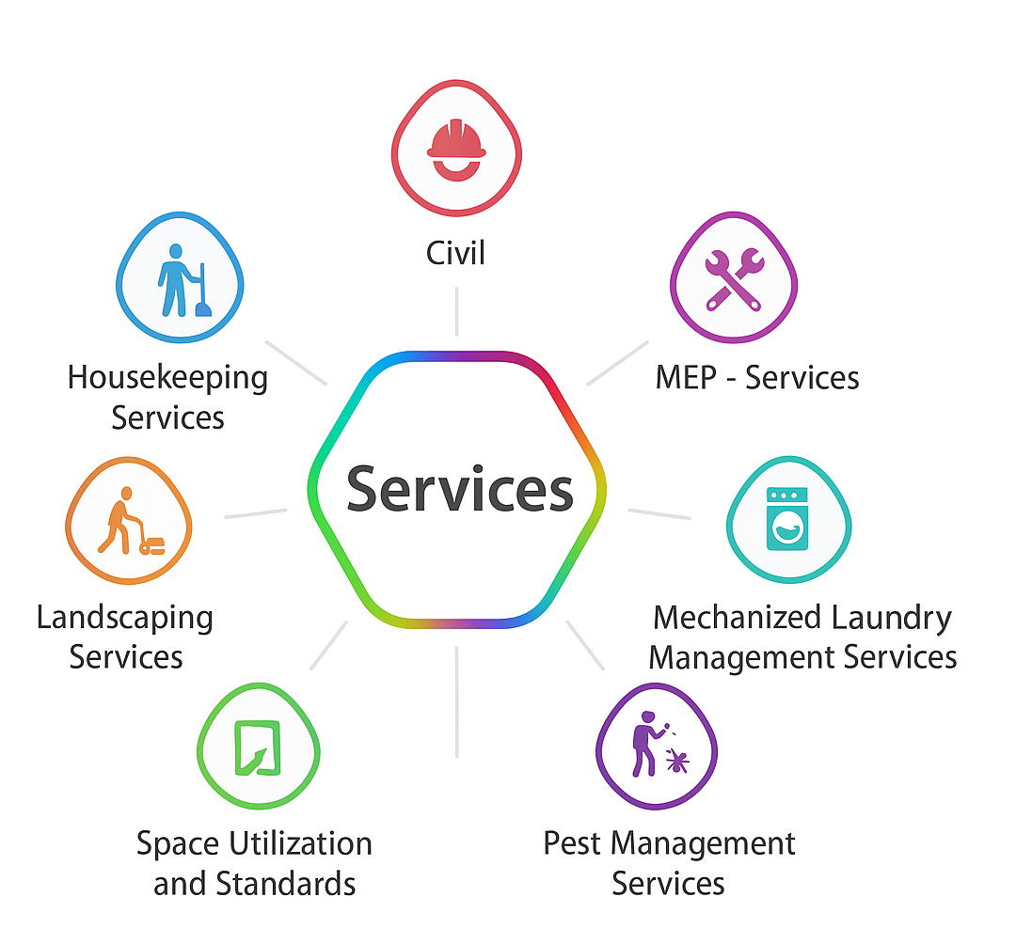


Services
NAMAMI INDIA SUPPORT SERVICES

Slide 7



Soft Services
House Kipping Services
Smart & Hygienic House Keeping Management, upkeep of the building including facade & water bodies, as per the international standards including decoration with an eye for details.
Smart Cleaning Program is being implemented with microfibre systems. With its technologically advanced methods and scientific approach that eradicates traditional mop and bucket systems, Smart Cleaning Program ensures healthy work place environment for everyone.
NAMAMI INDIA SUPPORT SERVICES

Slide 8


Landscaping Service
To maintain the Grounds (Hard/Soft), water bodies, gardens, Trees, Potted Plants(indoors & out doors), lawns & flower beds with seasonal plants.
NAMAMI INDIA SUPPORT SERVICES

Slide 9


Space Utilization Standard
Along with building services, dealing with office spaces for space optimization, can also be under the responsibility of the facilities department.
NAMAMI INDIA SUPPORT SERVICES

Slide 10


Pest Management Services
To maintain the entire work place along with kitchen, cafeteria, pantries etc. free of all pests & rodents ( one can well imagine the colossal damage which can be caused by a rodent / mice by nibbling/ gnawing a data cable in an office space.
NAMAMI INDIA SUPPORT SERVICES

Slide 11



Mechanized Laundry Services
Management (Operation & Maintenance) of mechanized laundry in hospitality sector i.e. 5 Star hotels & large camps/Campuses is also included as part of IFM services of Loops .
NAMAMI INDIA SUPPORT SERVICES

Slide 12


Pantry, Cafeteria, Catering & Guesthouse Management Services
A decent, hygienic & composite pantry, vending service, cafeteria & mess management .also falls under the preview of IFM.
NAMAMI INDIA SUPPORT SERVICES

Slide 13


Civil Services
Our Focus on Quality, Safety and Budget Work
Undertaking technical and feasibility studies including site investigations
Using a range of computer software for developing detailed designs
Undertaking complex calculations
liaising with clients and a variety of professionals including architects and subcontractors
Compiling job specs and supervising tendering procedures
Resolving design and development problems
Managing budgets and project resources
Scheduling material and equipment purchases and deliveries
Making sure the project complies with legal requirements, especially health and safety
Assessing the sustainability and environmental impact of projects
Ensuring projects run smoothly and structures are completed within budget and on time
NAMAMI INDIA SUPPORT SERVICES

Slide 14


MEP Services
Mechanical, Electrical, and Plumbing services
Our focus is on minimizing maintenance costs and optimizing plant availability, with the emphasis on safety. We firmly believe in maintaining an absolutely safe working environment. Towards this end, our Safety Department continuously trains, motivates and audits the sites where our employees work. This is facilitated by well-established systems, procedures, manuals and work instructions. We also extend our support services to pre-commissioning, erection and commissioning of power plants, and shutdown services. We provide clients with performance-based operation and maintenance services or only maintenance services on a turnkey basis—all of which result in:
Optimum plant availability
Minimization of maintenance cost
Optimization of inventory
Reduced downtime and surprise breakdowns
NAMAMI INDIA SUPPORT SERVICES

Slide 15
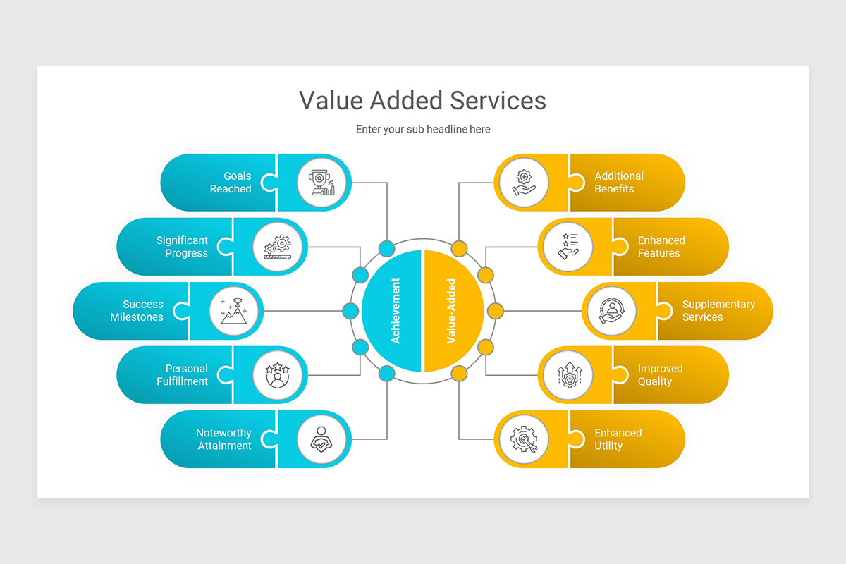

Reports
Namami maintains checks & balances through various process & procedures of daily check lists, reports to provide a comprehensive daily, monthly, quarterly, annual reports & MIS which will reflects its efficiency.
Value Add
Namami stretches to provide any service with a professional approach to meet the expectations of its clients & adds value to their Property / Business & improves their Asset Value by carrying out & providing various Audit / Analysis Reports.
NAMAMI INDIA SUPPORT SERVICES

Slide 16


Our Security Solutions
We are flexible and adaptable to your needs.
We serve across multiple segments.
We have a strong regional reach and approach.
We are backed by carefully selected personnel, ncluding ex-defence and fire & safety experts.
We offer a wide choice of on-site, mobile, and remote guarding systems
NAMAMI INDIA SUPPORT SERVICES

Slide 17
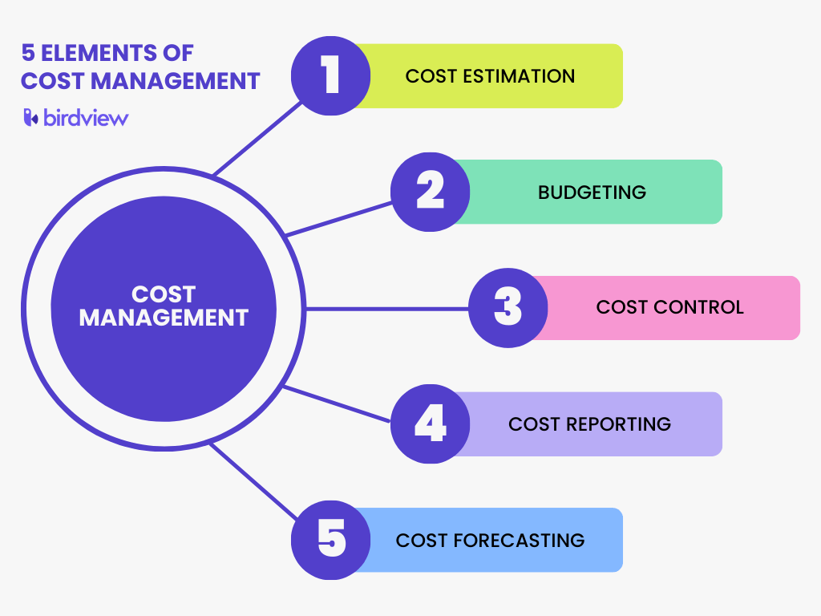

Cost Control Management
Our suggestions will help reduce your existing cost by the implementation of Cost Control Management
NAMAMI INDIA SUPPORT SERVICES

Slide 18








Our Clients
Digital Studio, Chennai
NAMAMI INDIA SUPPORT SERVICES

Slide 19



Contact
Backside of Gourishankar English Meduim School, Plot No - 239, Rudra Vihar, Sishupal Garh, Dhauli. Bhubaneshwar, Khordha,
Odisha – 751002
+91 96927 83839, +91 89176 29368, +91 9840110545
www.namamiindia.co.in
info@namamiindia.co.in
NAMAMI INDIA SUPPORT SERVICES

Slide 20



Thanks You

